Slide 1
Seminar Project: Initial Ideas
Group A9

Slide 2
TABLE OF CONTENTS
Recap: main tasks
Chart of processes
[Xu Liu et al.] Robust Fruit Counting
Preliminary conclusion
[H. Gan et al.] Immature green citrus fruit detection using color and thermal images
Conclusion
Bonus: our first experiments

Slide 3
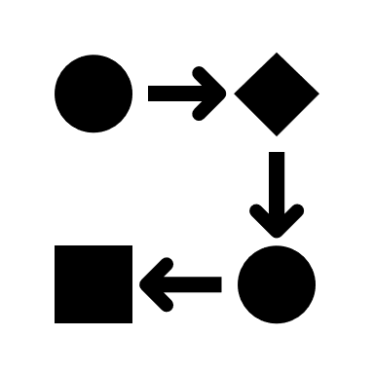




Recap: Main Tasks
pre-processing
tracking
counting
detection

Slide 4
Chart of processes
Image Data | RGB |  | Thermal
Calibration
Pre-processing | Filter out non-peach colors | Masking | Histogram equalization | Remove shadows
Noise removal
Detection (Segmentation) | Circular Hough transform | K-means clustering | Machine learning | Watershed segmentation | Blob detection
Tracking | Kalman filter | Robust features; SIFT
Counting | Remove doubles | Remove further rows | Remove false positives

Slide 5
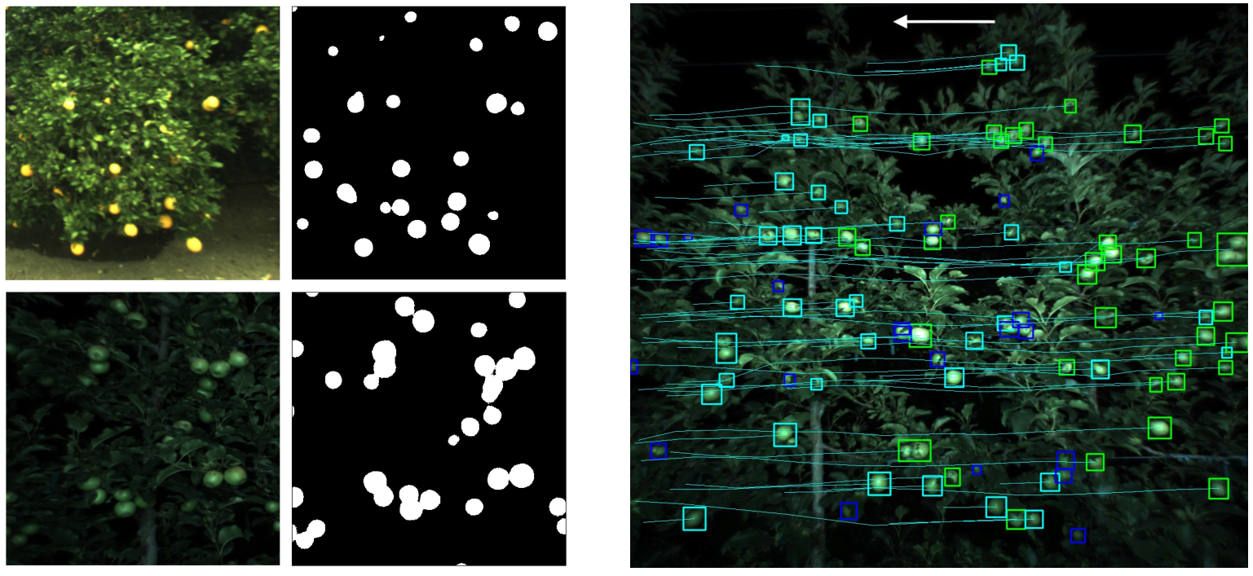
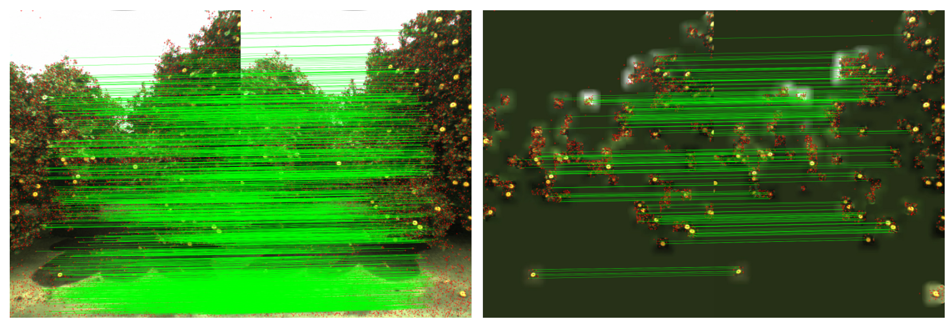
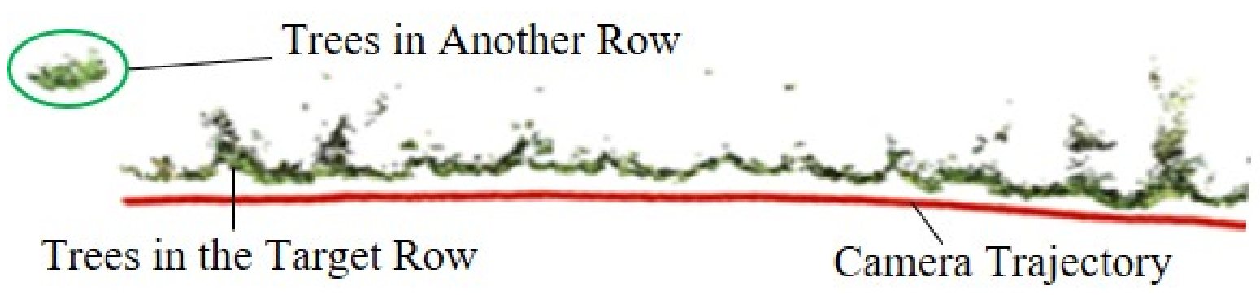
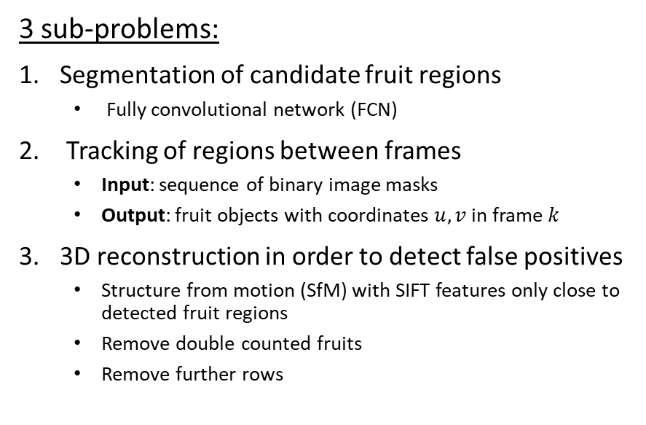
[Xu Liu et al.] Robust Fruit Counting
3 sub-problems:
Segmentation of candidate fruit regions
Fully convolutional network (FCN)
Tracking of regions between frames
Input: sequence of binary image masks
Output: fruit objects with coordinates $u,v$ in frame $k$
3D reconstruction in order to detect false positives
Structure from motion (SfM) with SIFT features only close to detected fruit regions
Remove double counted fruits
Remove further rows

Slide 6
Image Data | RGB |  | Thermal
Calibration
Pre-processing | Filter out non-peach colors | Masking | Histogram equalization | Remove shadows
Noise removal
Detection (Segmentation) | Circular Hough transform | K-means clustering | Machine learning | Watershed segmentation | Blob detection
Tracking | Kalman filter | Robust features; SIFT
Counting | Remove doubles | Remove further rows | Remove false positives

Slide 7

Preliminary conclusion
A CNN (if it works) could provide for an easy solution to segmentation
Must try it out to see if it works
Structure from motion only for relevant parts?
Could potentially improve quality of 3D reconstruction
Something
Something
→ But what if segmentation only using color images fails?

Slide 8
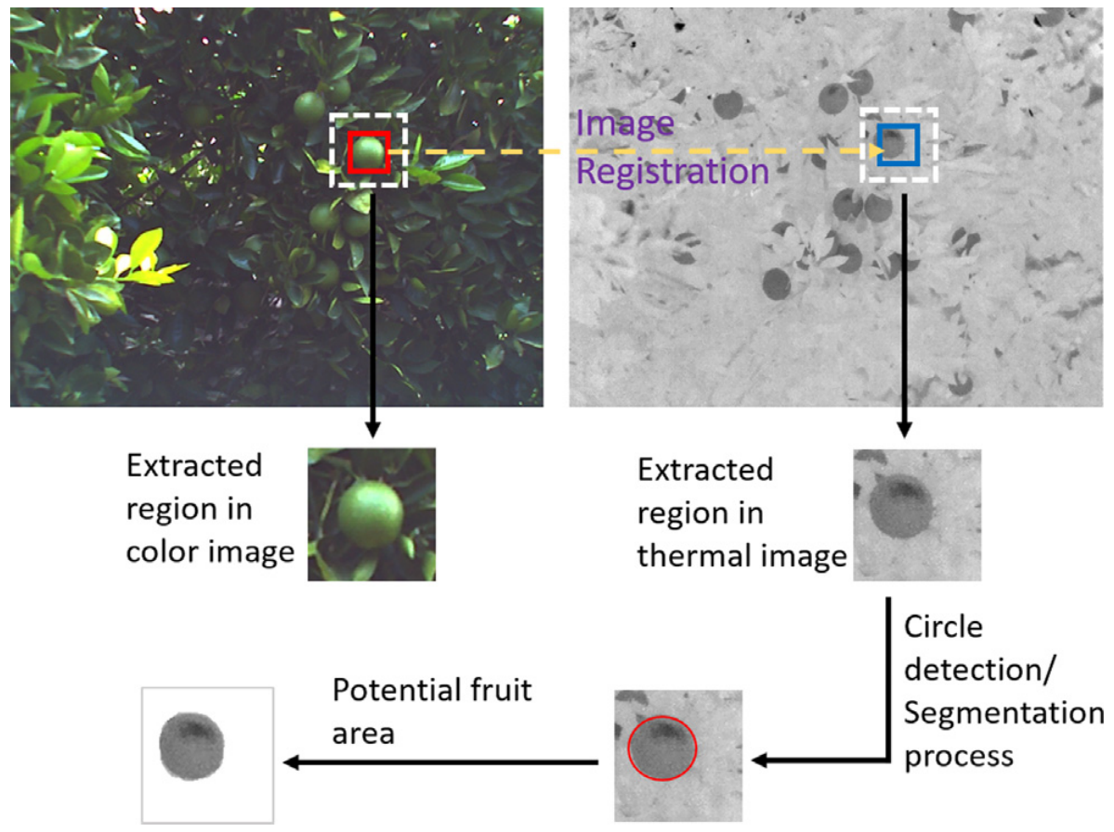
[H. Gan et al.] Immature green citrus fruit detection using color and thermal images
Main ideas:
Faster R-CNN for fruit detection in color images
Get bounding boxes of potential fruits
Each image had to be split into 4 to fit into the CNN
Hough circle detection in thermal images
If that fails, use Otsu's method
Combine color and thermal information into final equation to determine probability of fruit
→ Promising method if only using color images fails

Slide 9
Image Data | RGB |  | Thermal
Calibration
Pre-processing | Filter out non-peach colors | Masking | Histogram equalization | Remove shadows
Noise removal
Detection (Segmentation) | Circular Hough transform | K-means clustering | Machine learning | Watershed segmentation | Blob detection
Compare color and thermal images
Tracking | Kalman filter | Robust features; SIFT
Counting | Remove doubles | Remove further rows | Remove false positives

Slide 10
Conclusion
Try to use color images only
→ If results not satisfactory, use thermal also
Use machine learning as a quick and dirty solution
→ Traditional methods (e.g. Hough, K-means) otherwise
Something
Something

Slide 11
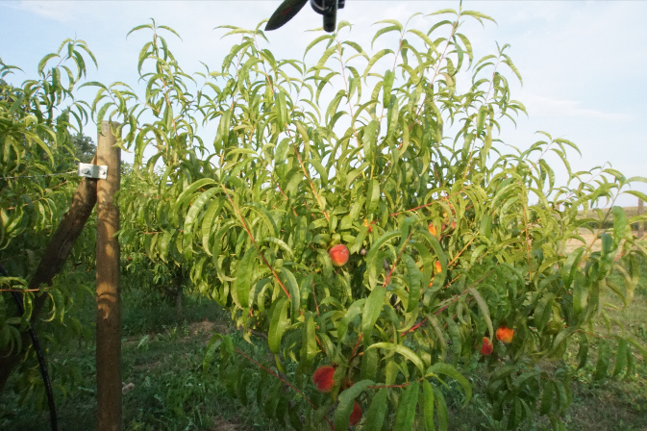
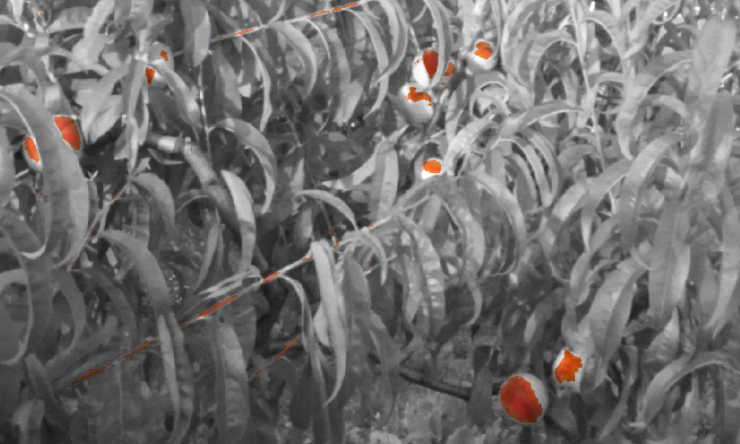
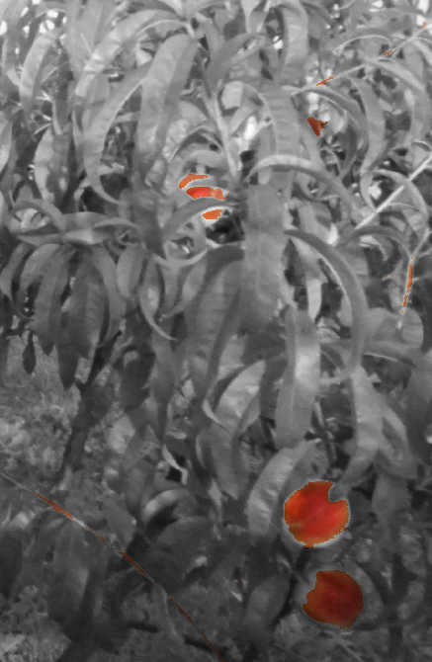
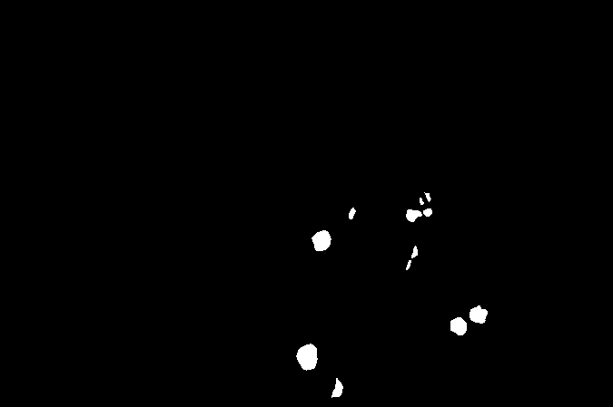
Bonus: our first experiments
We manually labeled the images for training
Naïve color filtering for segmentation?

Slide 12
Thank you!
Group A9

